Slide 1
Automated Software Testing
08. Test automation, reporting, and metrics

Slide 2

The student can:
Purpose of Reporting in Test Automation
Can describe the purpose of reporting in test automation, including:
  Status reporting for stakeholders.
  Metrics to track progress and quality.
  Supporting the investigation and resolution of test failures.
Understands the importance of clear and actionable test automation reports for decision-making.
Notes:
Learning Goals
The student:
Purpose of Reporting in Test Automation
Can describe the purpose of reporting in test automation, including:
Status reporting for stakeholders.
Metrics to track progress and quality.
Supporting the investigation and resolution of test failures.
Understands the importance of clear and actionable test automation reports for decision-making.
Test Automation Metrics
Can identify different metrics to improve a Test Automation Solution (TAS).
Can describe indicators that demonstrate the benefits of TAS.
Understands the lifecycle of a test in a TAS and its relationship with reporting and metrics.
Can explain the challenges and opportunities of handling mass testing and deriving meaningful insights from mass data.
Knows the quality criteria for effective reports.

Slide 3
The student:
Metrics and Indicators in Practice
Can identify the key aspects of a metric.
Can provide at least two examples of valid metrics for a TAS.
Can analyze and interpret metrics to derive insights for improving TAS.

Slide 4
The student can:
Test Automation Metrics
Can identify different metrics to improve a Test Automation Solution (TAS).
Can describe indicators that demonstrate the benefits of TAS.
Understands the lifecycle of a test in a TAS and its relationship with reporting and metrics.
Can explain the challenges and opportunities of handling mass testing and deriving meaningful insights from mass data.
Knows the quality criteria for effective reports.
Notes:
Learning Goals
The student:
Purpose of Reporting in Test Automation
Can describe the purpose of reporting in test automation, including:
Status reporting for stakeholders.
Metrics to track progress and quality.
Supporting the investigation and resolution of test failures.
Understands the importance of clear and actionable test automation reports for decision-making.
Test Automation Metrics
Can identify different metrics to improve a Test Automation Solution (TAS).
Can describe indicators that demonstrate the benefits of TAS.
Understands the lifecycle of a test in a TAS and its relationship with reporting and metrics.
Can explain the challenges and opportunities of handling mass testing and deriving meaningful insights from mass data.
Knows the quality criteria for effective reports.

Slide 5
The student:
Maven Fundamentals
Can describe what Maven is and its purpose in build and project management.
Understands Maven’s lifecycle, including:
  Phases (e.g., validate, compile, test, package, install, deploy).
  Goals and their execution in specific phases.
Can explain how Maven uses plugins to extend functionality, such as the Surefire and Failsafe plugins.
Knows the purpose of the Surefire plugin for running unit tests and generating test reports.
Understands the role of the Failsafe plugin in executing integration tests and generating reports.
Can generate and interpret test reports.

Slide 6
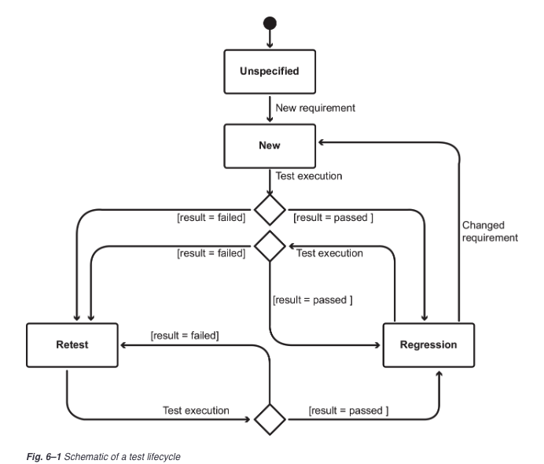
Lifecycle
of a test

Slide 7
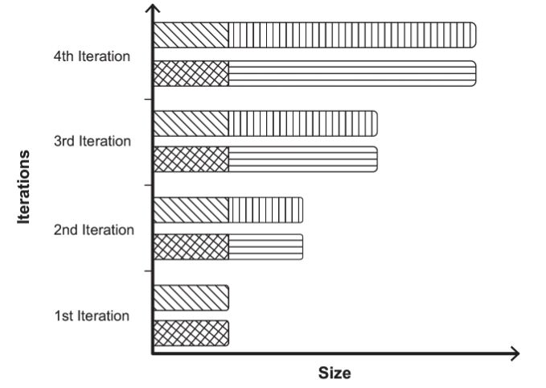
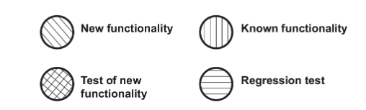
Frequency of test execution
Notes:
Regression testing is a prime candidate for automation due to its innate frequency of execution and its fault detection potential. In other words, regression testing is often the main reason for transitioning from manual to automated testing.
Ideally, manual tests for new or changed functionality at the various test levels are immediately added to an automated regression test suite as soon as the functionality is accepted by its stakeholders. This ensures that the new or changed functionality and its code base are adequately covered when the regression test suite is re-run. This significantly increases the chances that a regression in the SUT’s legacy functionality or code base is detected.

Slide 8
Mass testing creates mass data
Every execution of a test, whether automated or manual, generates extra work products, such as test logs.
Each of these work products potentially provides a valuable contribution to the evaluation of the SUT’s overall quality. This in turn means that all the test logs should be analyzed by testers, especially those relating to failed tests.

Slide 9
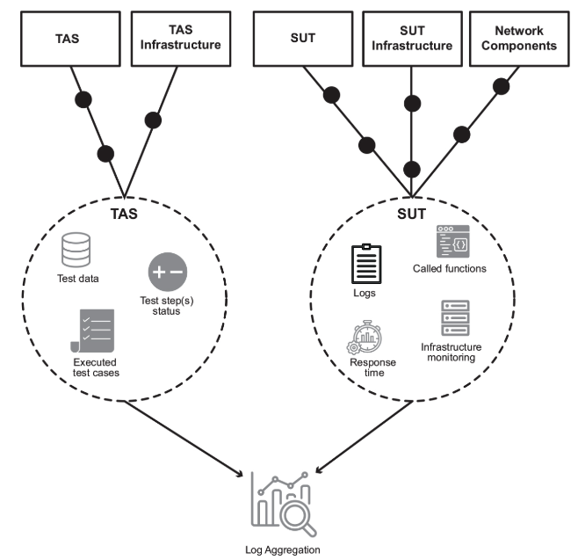
Log sources

Slide 10
Purpose of Reporting
Status reporting
Metrics
Supporting test failure investigation
Measuring success
Identify areas for improvement
Notes:
Status reporting: for everyone who wants to see progress - like number of tests passing or failing. Keep all stakeholders up to date, a dashboard can be an effective solution.
Metrics: things we want to measure and track over time to identify the areas we want to improve.

Slide 11
Quality criteria for reports
Must be a valid representation of reality
A report must be created with the target audience in mind
A report’s format and publication channel must be compatible with its intended use
A report should indicate which types of valid interpretations can be made and which types of inferences are invalid

Slide 12
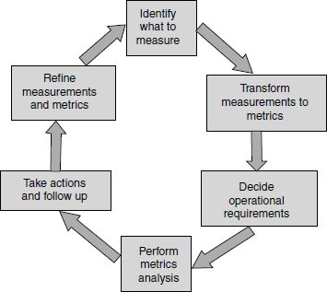
Metrics
Metrics derive information from raw data with a view to help in decision making.
Notes:
metrics = statistieken [NL]

Slide 13
Why metrics in testing?
Testing is the penultimate phase before product release.
It’s essential to measure the progress of testing and the product quality.
test case execution productivity = test cases that can be executed per person day
estimate test completion date
defect trend = estimate of the defects that will come through future test cycles
defect-fixing capability = the number of defects that can be fixed in a particular period
both are important to be able to calculate the date the product can be released.

Slide 14
Why metrics in testing?
Metrics in testing help in identifying:
when to make the release
what to release (defect density across modules)
whether the product is being released with the known quality

Slide 15
Aspects of a metric
Validity
Objectivity
Reliability
Notes:
Validity
Definition: Validity checks if a metric accurately measures what it claims to measure.
Example: Does "number of bugs" reflect software quality effectively?
Objectivity
Definition: Objectivity ensures the metric is not influenced by subjective judgment or testing conditions.
Example: A metric like "test execution time" is objective if it is measured using an automated stopwatch rather than estimated by a tester, which might vary based on human perception or conditions.
Reliability
Definition: Reliability assesses if the metric produces consistent and reproducible results under the same conditions.
Example: If you run the same automated test suite multiple times, the number of test failures should be consistent. If it varies due to flaky tests or unstable environments, the metric lacks reliability.
Level of Measurement and Valid Operations (Usability)
The type of scale used (nominal, ordinal, interval, or ratio) determines what kind of analysis can be performed.

Slide 16
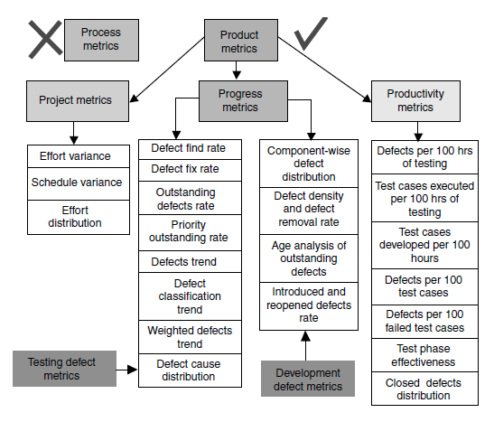
Types of Metrics
Notes:
Resource: Software testing: principles and practices, Srinivasan Desikan, Gopalaswamy Ramesh
Project metrics A set of metrics that indicates how the project is planned and executed.
Progress metrics A set of metrics that tracks how the different activities of the project are progressing. The activities include both development activities and testing activities. Since the focus of this book is testing, only metrics applicable to testing activities are discussed in this book (and in this chapter). Progress metrics is monitored during testing phases. Progress metrics helps in finding out the status of test activities and they are also good indicators of product quality. The defects that emerge from testing provide a wealth of information that help both development team and test team to analyze and improve. For this reason, progress metrics in this chapter focus only on defects. Progress metrics, for convenience, is further classified into test defect metrics and development defect metrics.
Productivity metrics A set of metrics that takes into account various productivity numbers that can be collected and used for planning and tracking testing activities. These metrics help in planning and estimating of testing activities.

Slide 17
Examples of TAS (test automation solution) metrics
Effort/Time required to build automated tests
Effort/Time required to analyze automated test incidents
Effort/Time required to maintain automated tests
Ratio of failures to defects (failure of multiple tests reveal the same defects)
Time to execute automated tests
Number of automated test cases
Number of pass and fail results
Code/Test coverage
Notes:
Automation benefits. An external metric that can, for example, be used as a basis for ROI analysis.
■Effort required to build automated tests. An external metric that can be used for project planning, but that can also provide valuable information about TAS optimization.
■Effort required to analyze automated test incidents. An external metric that provides insight into the efficiency of the troubleshooting process and that helps to identify optimization potential or weaknesses in the process.
■Effort required to maintain automated tests. An external metric that can reveal weaknesses in the TAS (for example, insufficient abstraction in test case descriptions) as well as in SUT/TAS synchronization (for example, when changes to user interface are not adequately communicated).
■Ratio of failures to defects. An external metric used to evaluate the efficiency of automated testing in finding defects. If multiple tests frequently reveal the same defects, this indicates a potential waste of resources.
■Time to execute automated tests. An external metric that determines whether a certain amount of test cases can be executed within a predefined time window (for example, regression tests in a two-hour nightly), but also to detect trends (improvements and downturns).
■Number of automated test cases. An external metric that provides little insight when viewed in isolation. However, as a trend and in the context of other metrics (for example, coverage rate), it enables you to draw conclusions regarding overall project progress.
■Number of pass and fail results. An external metric that provides a quick overview of the overall state of the SUT and the TAS. However, to serve as a basis for decision-making, the cause of the failures must also be analyzed and evaluated.
■Number of false-positive and false-negative results. An external metric that helps to identify avoidable additional work, but that also points to weaknesses in the TAS itself or in TAS/SUT synchronization.
■Code coverage. An external metric that can measure both code and requirements coverage. When captured and viewed objectively, it provides information about project progress, but also about insufficiently tested test objects.
■Tool scripting metrics. A set of internal metrics that can be used to monitor the development of automation scripts. This can ensure compliance with conventions (such as style guides) and provides information about the quality of the source code (for example, lines of code, complexity of methods, coherence and cohesion of artifacts).
■Automation code defect density. An internal metric that is particularly relevant when defects in the TAS result in a high level of additional work.
■Speed and efficiency of TAS components. A primarily internal metric, useful especially when optimization measures are planned or implemented. This is the only way to objectively evaluate the success of such measures.

Slide 18
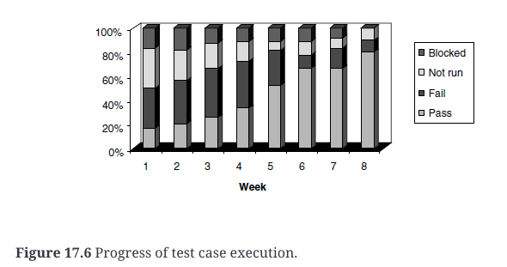
Progress metric example

Slide 19
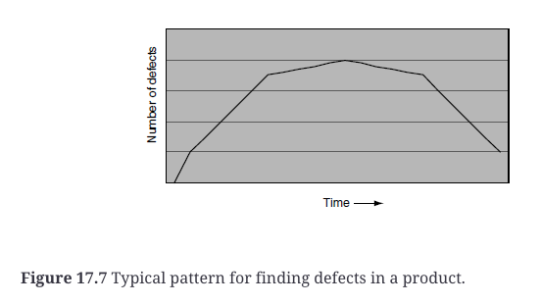
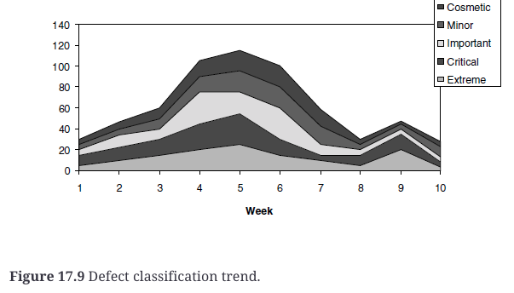

Slide 20
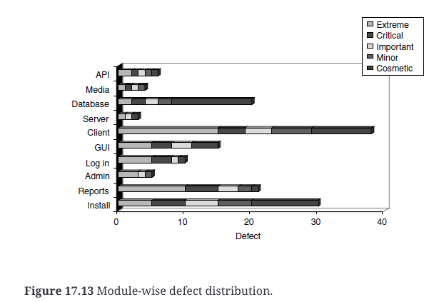
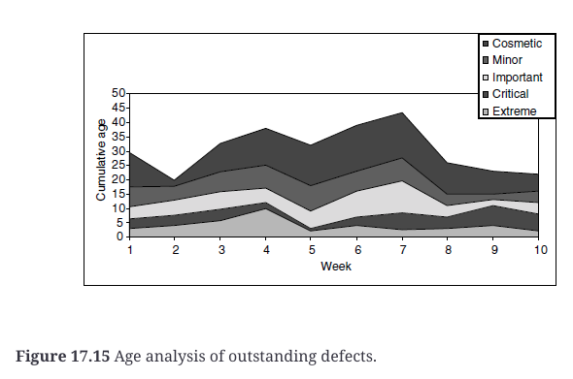

Slide 21
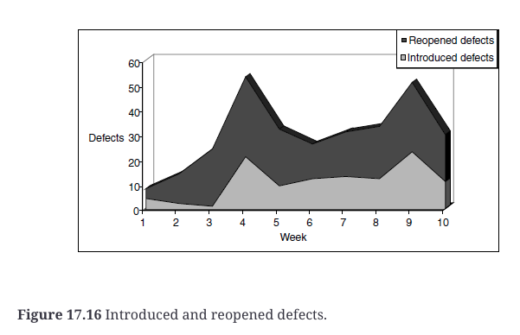

Slide 22
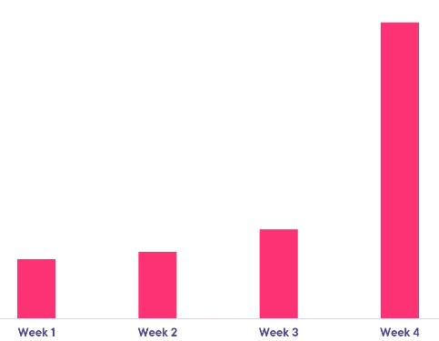
Identify areas for improvement
Test suite run time

Slide 23
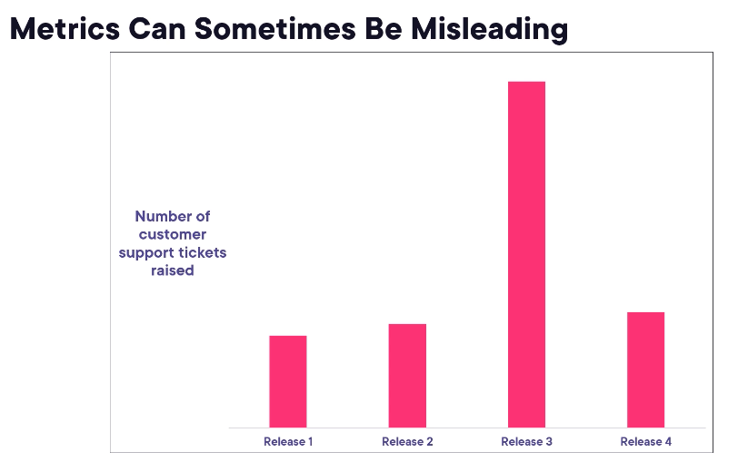
Anomalies in metrics
Notes:
Did something go wrong with the test automation during release 3?
Other reasons: many new users, size of release, …

Slide 24

Test Failure Investigation
First step to fix is to recreate the failure
Test results
Informative error messages
Screenshot and videos
Environment details
Name of test

Slide 25
Benefits of using a TAS
Indicators for the success of the TAS
The number of hours saved on manual tests
The reduction in time taken for regression test execution
The number of additional test execution cycles completed
The percentage of additional tests executed
The proportion of automated test cases in relation to the total number of test cases
Any increase in coverage (requirements, functional scope, structural)
The number of defects found earlier thanks to the TAS
The number of defects found thanks to the TAS that would not have been found at all through manual testing (for example, reliability defects)
Notes:
Measuring the success of the TAS

Slide 26
Maven surefire and failsafe plugin
maven-surefire-plugin is designed for running unit tests and if any of the tests fail then it will fail the build immediately.
maven-failsafe-plugin is designed for running integration tests, and decouples failing the build if there are test failures from actually running the tests.
Notes:
mvn clean verify -Dbase.url=http://localhost:8080/

Slide 27
Maven built-in life cycles
3 build lifecycles: default, clean and site
clean | handles the cleanup of directories and files generated during the build process | mvn clean
default | handles the build and distribution of the project | mvn [plugin:goal]* [phase]*
site | create project documentation | mvn site

Slide 28
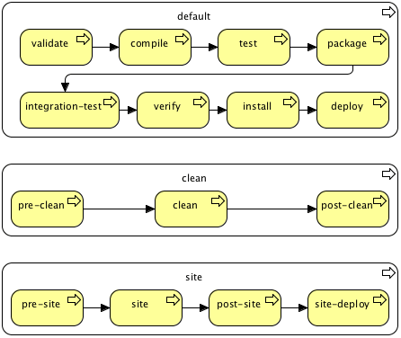
A Build Lifecycle Is Made Up Of Phases
Each build lifecycle is defined by a sequence of phases.
Whenever a maven command for any life cycle is invoked, maven executes the phases till and up to the invoked phase.
$mvn clean install
Notes:
https://maven.apache.org/guides/introduction/introduction-to-the-lifecycle.html#Lifecycle_Reference
Which phases will be executed with the command mvn clean install?

Slide 29
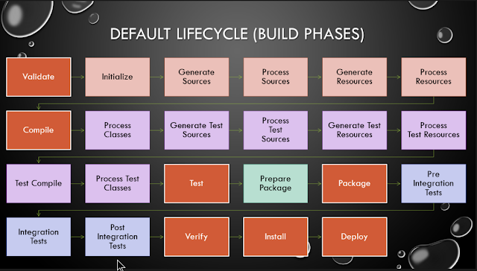

Slide 30
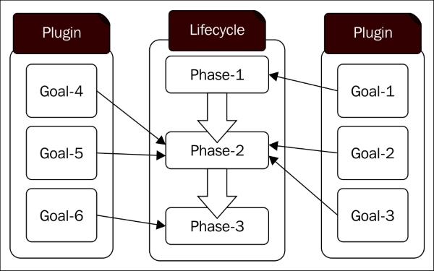
Plugins and goals (1/2)
Notes:
A plugin goal represents a specific task (finer than a build phase) which contributes to the building and managing of a project. It may be bound to zero or more build phases. A goal not bound to any build phase could be executed outside of the build lifecycle by direct invocation. The order of execution depends on the order in which the goal(s) and the build phase(s) are invoked.
For example, consider the command below. The clean and package arguments are build phases, while the dependency:copy-dependencies is a goal (of a plugin).
mvn clean dependency:copy-dependencies package
If this were to be executed, the clean phase will be executed first (meaning it will run all preceding phases of the clean lifecycle, plus the clean phase itself), and then the dependency:copy-dependencies goal, before finally executing the package phase (and all its preceding build phases of the default lifecycle).
https://maven.apache.org/guides/introduction/introduction-to-the-lifecycle.html#a-build-phase-is-made-up-of-plugin-goals

Slide 31
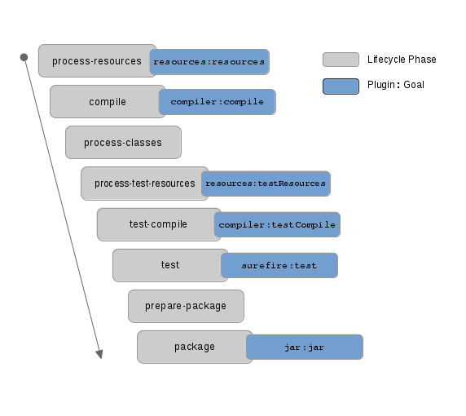
Plugins and goals (2/2)

Slide 32
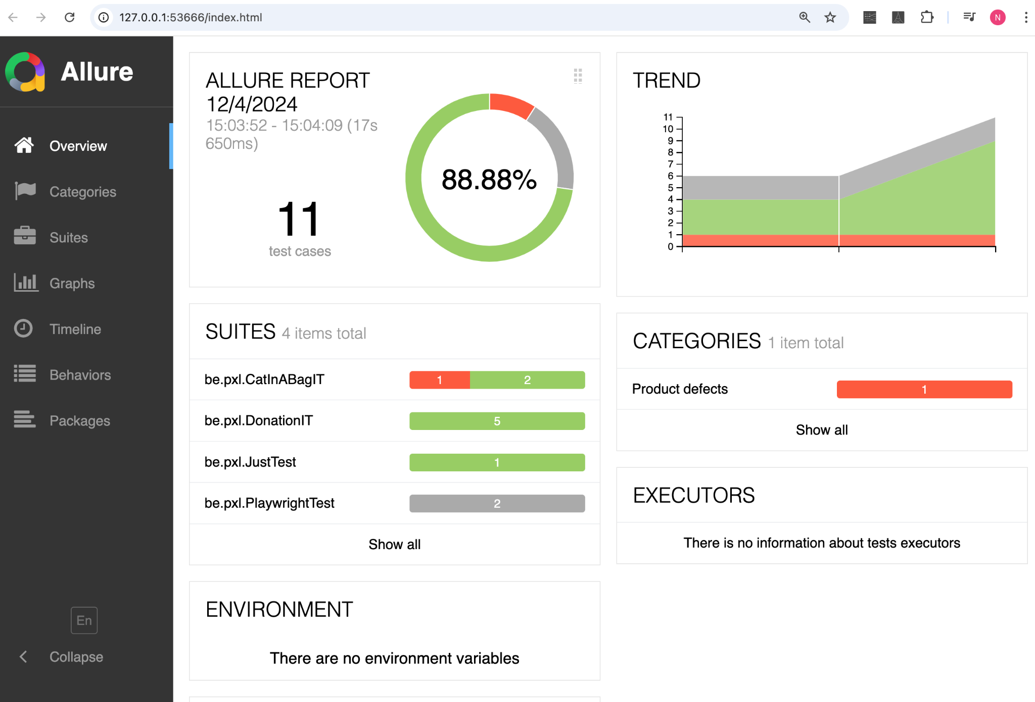
Demo: Allure Report
Notes:
copy allure-reports/history to allure-results
allure generate --clean target/allure-results/
allure open allure-reports

